Slide 1
Notes:
INTRODUCTION OF PRESENTATION-DEE
Music Playing-Little Drummer Boy
https://youtu.be/wwM9Mnfm3ko

Slide 2
Notes:
INTRODUCE SELF–DEE

Slide 3
Notes:
INTRODUCTION OF ALEX-DEE

Slide 4
Notes:
ALL ABOUT THE ROE-DEE
9 Unit Districts
Serve students in urban, rural, wealth
120,000 students

Slide 5
OBJECTIVES
Gain a better understanding of the cultural experience of holiday celebrations in Mexico.
Obtain a stronger understanding of why the pilgrimage to Mexico is valuable to families.
Learn how to support students who are absent from school because of the pilgrimage.
Transfer the knowledge of this presentation to other cultures.
Notes:
OBJECTIVES: DEE

Slide 6
RATIONALE
Notes:
RATIONALE FOR PRESENTING ABOUT THIS: DEE
Meeting with Youth Outreach
Alex was relatively new to the ROE youth outreach program-she explained her trip to Mexico
Staff with many years of experience were amazed that they had never known what happens–including me
Discussion that comes up every year about students going to Mexico
Shift my perspective-How many times did I approve for kids to go to events that were not “educational” in the eyes of the school
Forget that students can learn anywhere-Parents are the first teachers

Slide 7
TRIP OVERVIEW & PLANNING
Holiday Dates: December 16 - January 6 (approximate)
Overview of Experience
Multi Day Religious & Cultural Experience
Different towns in Mexico have varied dates/experiences
Opportunity for celebration, prayer, faith, giving to others
Decisions
Dates of Travel
Method of Travel
Ticket Purchase(s)
Flying- Airfare cost
Driving-
Caravan Coordination
Temporary Vehicle Importation Permit (TIP)
Mexican Government Authority-Banjercito
Proper Vehicle Insurance
Notes:
ALEX
Planning for the journey, fundraising for participants plus fundraising for events/bands, “godparent/sponsorship” toys for kids
Brief Overview & Planning for the journey, fundraising for participants plus fundraising for events/bands, “godparent/sponsorship” toys for kids
Overview of Experience
Multi Day Religious & Cultural Experience
Different towns in Mexico have varied dates/experiences
Opportunity for celebration, prayer, faith, giving to others
Holiday Dates: December 16-January 6 (approximate)
Decisions
Dates of Travel
Method of Travel
Ticket Purchase Timeline
Flying- Sooner the better–lower cost airfare
Driving-
Caravan Coordination
Temporary Vehicle Importation Permit (TIP)
Mexican Government Authority-Banjercito
Proper Vehicle Insurance
Decide how will you travel there?
If Flying, you must purchase tickets with time
If Driving, you must plan in advance, to obtain a Temporary Vehicle Importation Permit (TIP) (Mexican government authority Banjercito) proper vehicle insurance, and coordinate a caravan with others.
Fundraisers are planned throughout the year to help pay for the cost of the Fiestas Patrias, and repairs that need to be made in the village (Roads, School, Church, Waterlines.. etc.,)
In addition, Godparents are selected well in advance, to gift children in the village, a Christmas gift.

Slide 8
Notes:
ALEX
Flying: at least one hour to get to airport, 3 hours in immigration, TSA, international, 4 hour flight, immigration again (time tbd), drive to town (2-3 hours depending on which town you are visiting)
Remove train
Car: 27 hours to border without stops, border patrol, drive to destination (10 hours)---time of day is a concern as nightime driving can be dangerous–criving in caravan

Slide 9
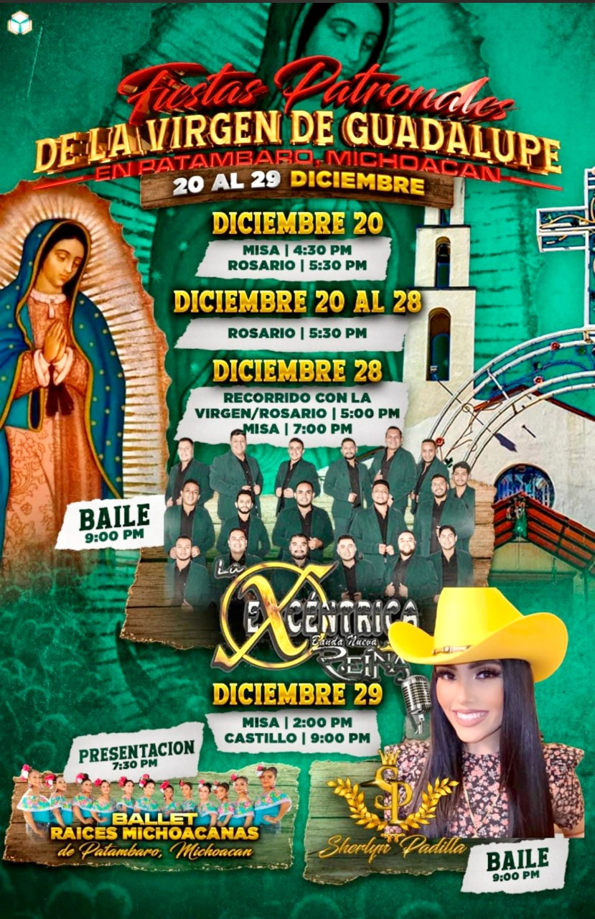
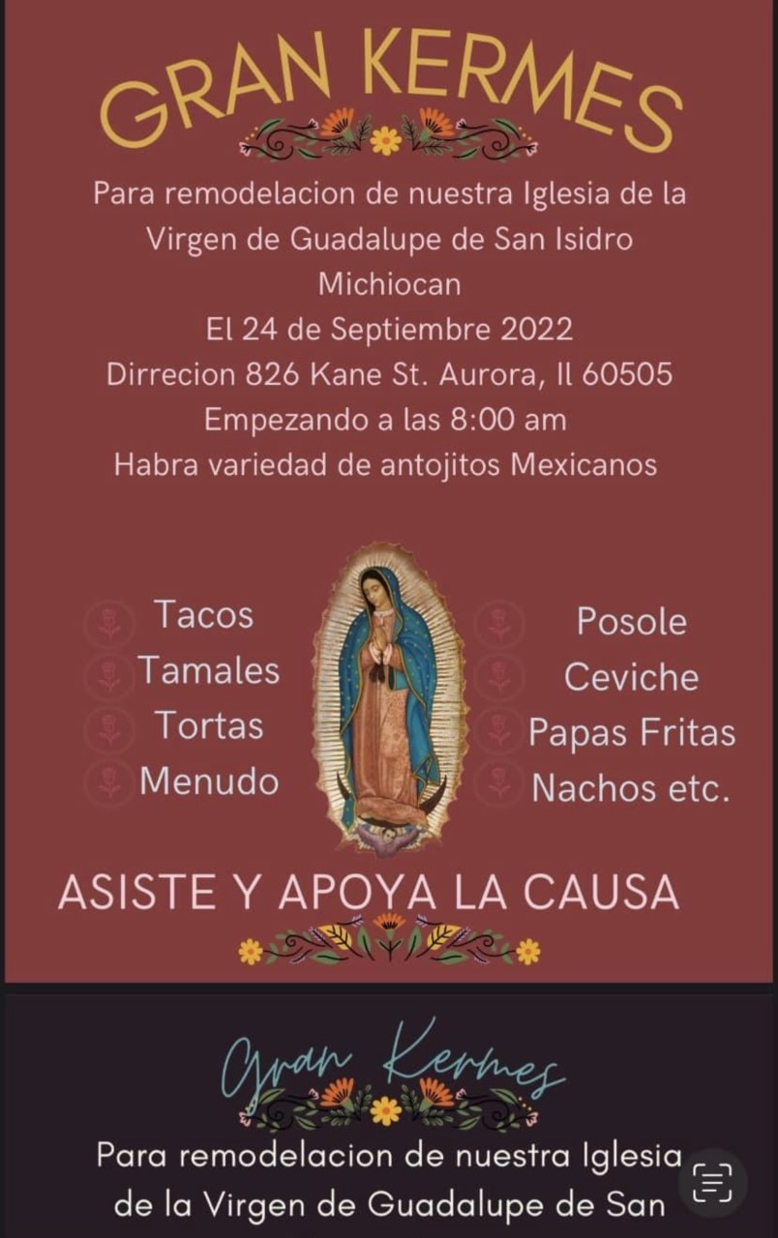
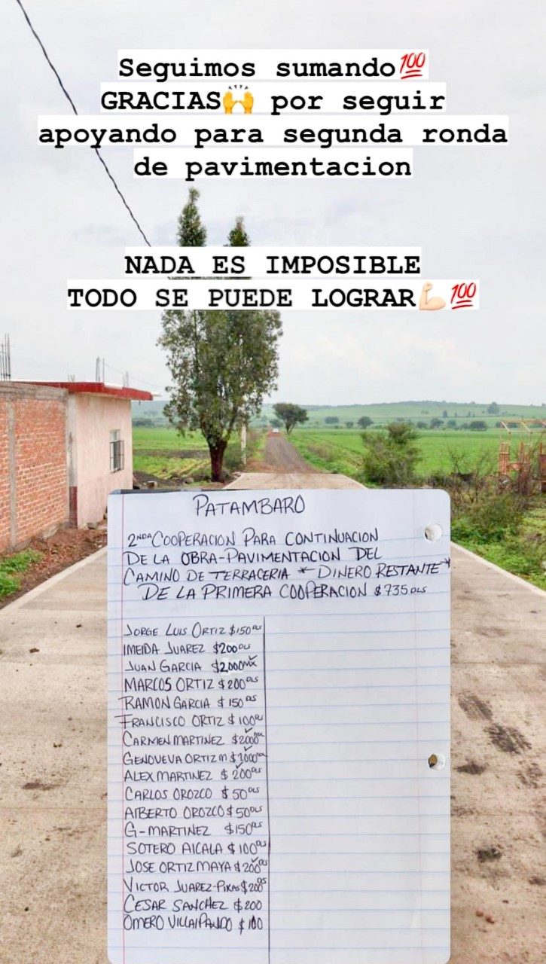
Fund Raising
Funds Needed For…
Traveler
Cash in the vehicle
Event expenses (Sponsorships)
Fiestas Patrias
Repairs for Village Roads, Schools, Church, Waterlines, etc.
Christmas gifts for children in the village.
Notes:
ALEX

Slide 10
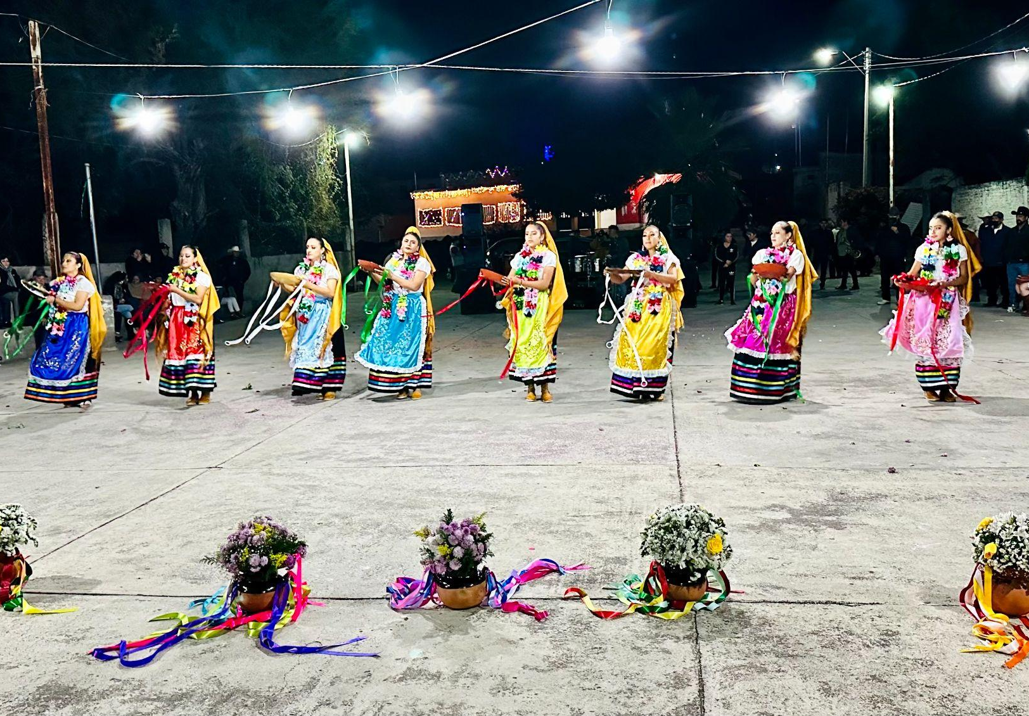
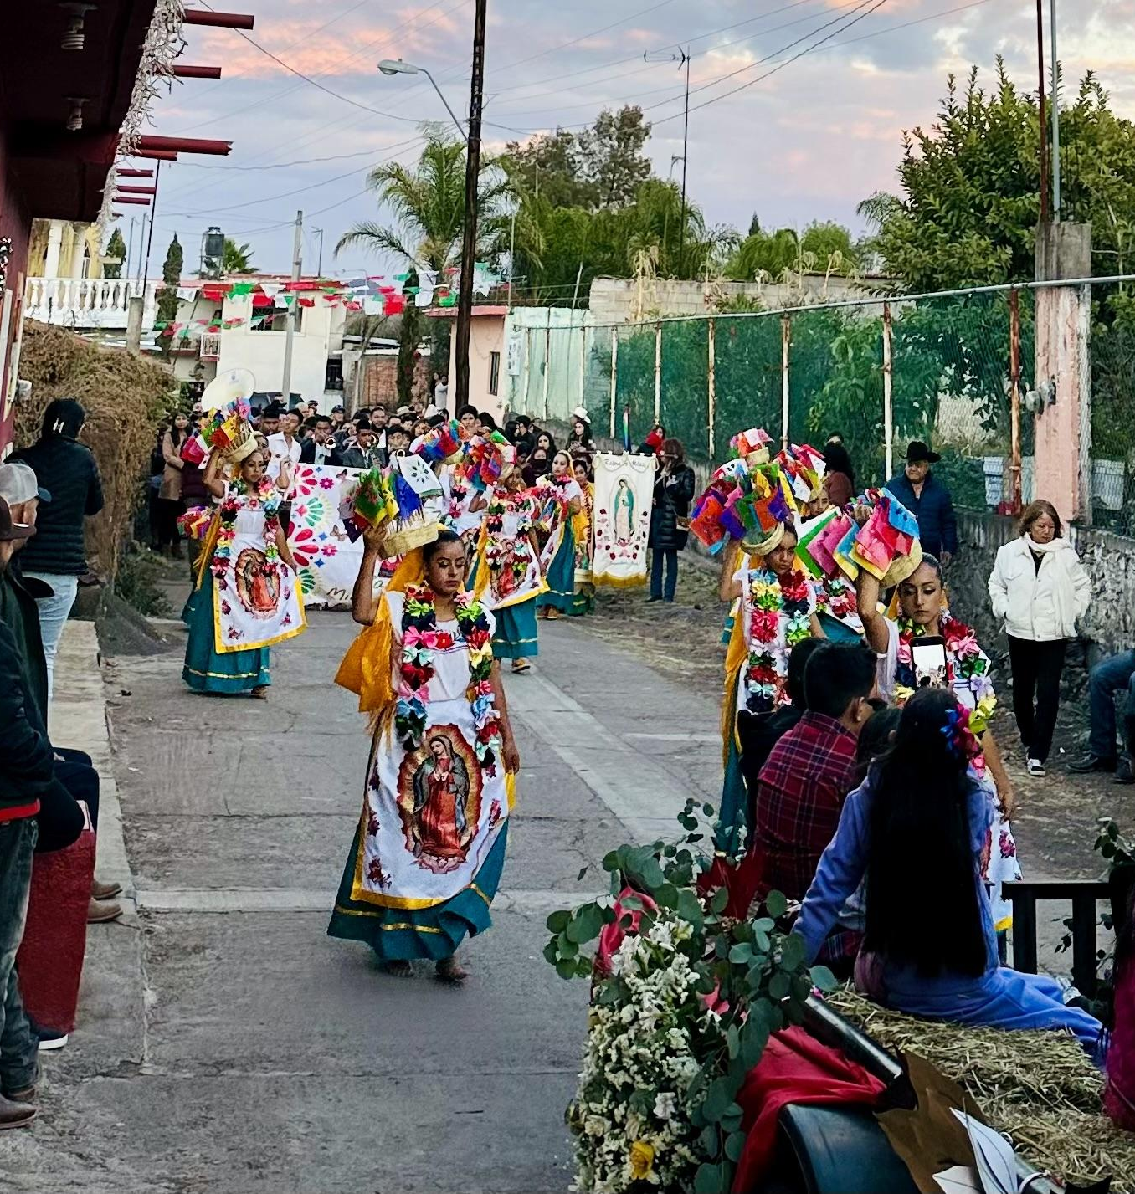
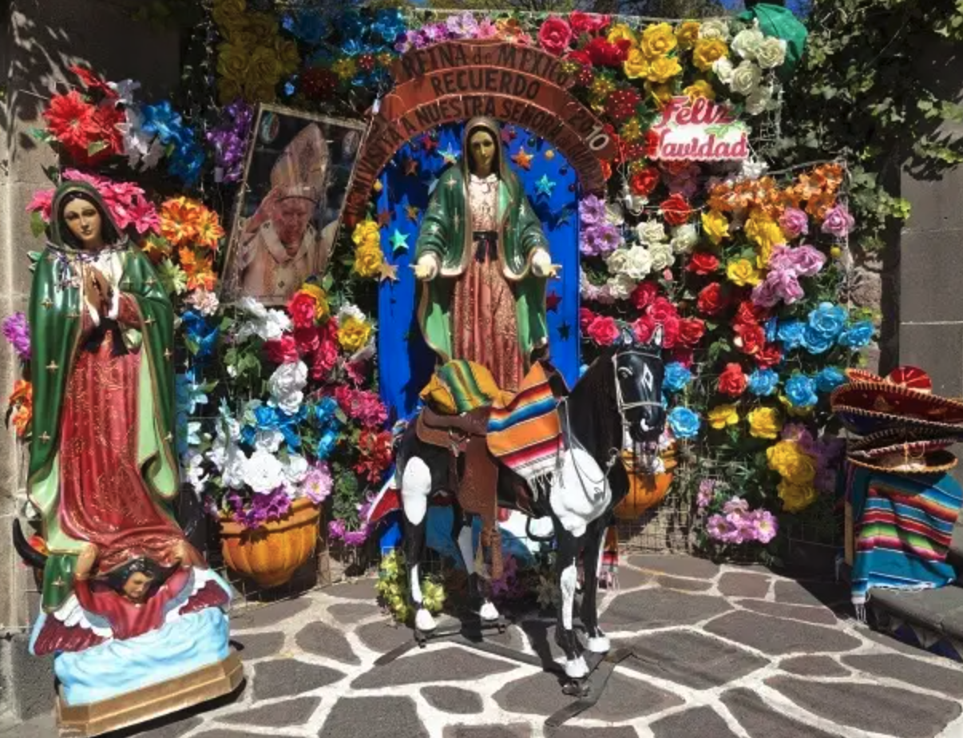
FIESTAS PATRIAS

Slide 11
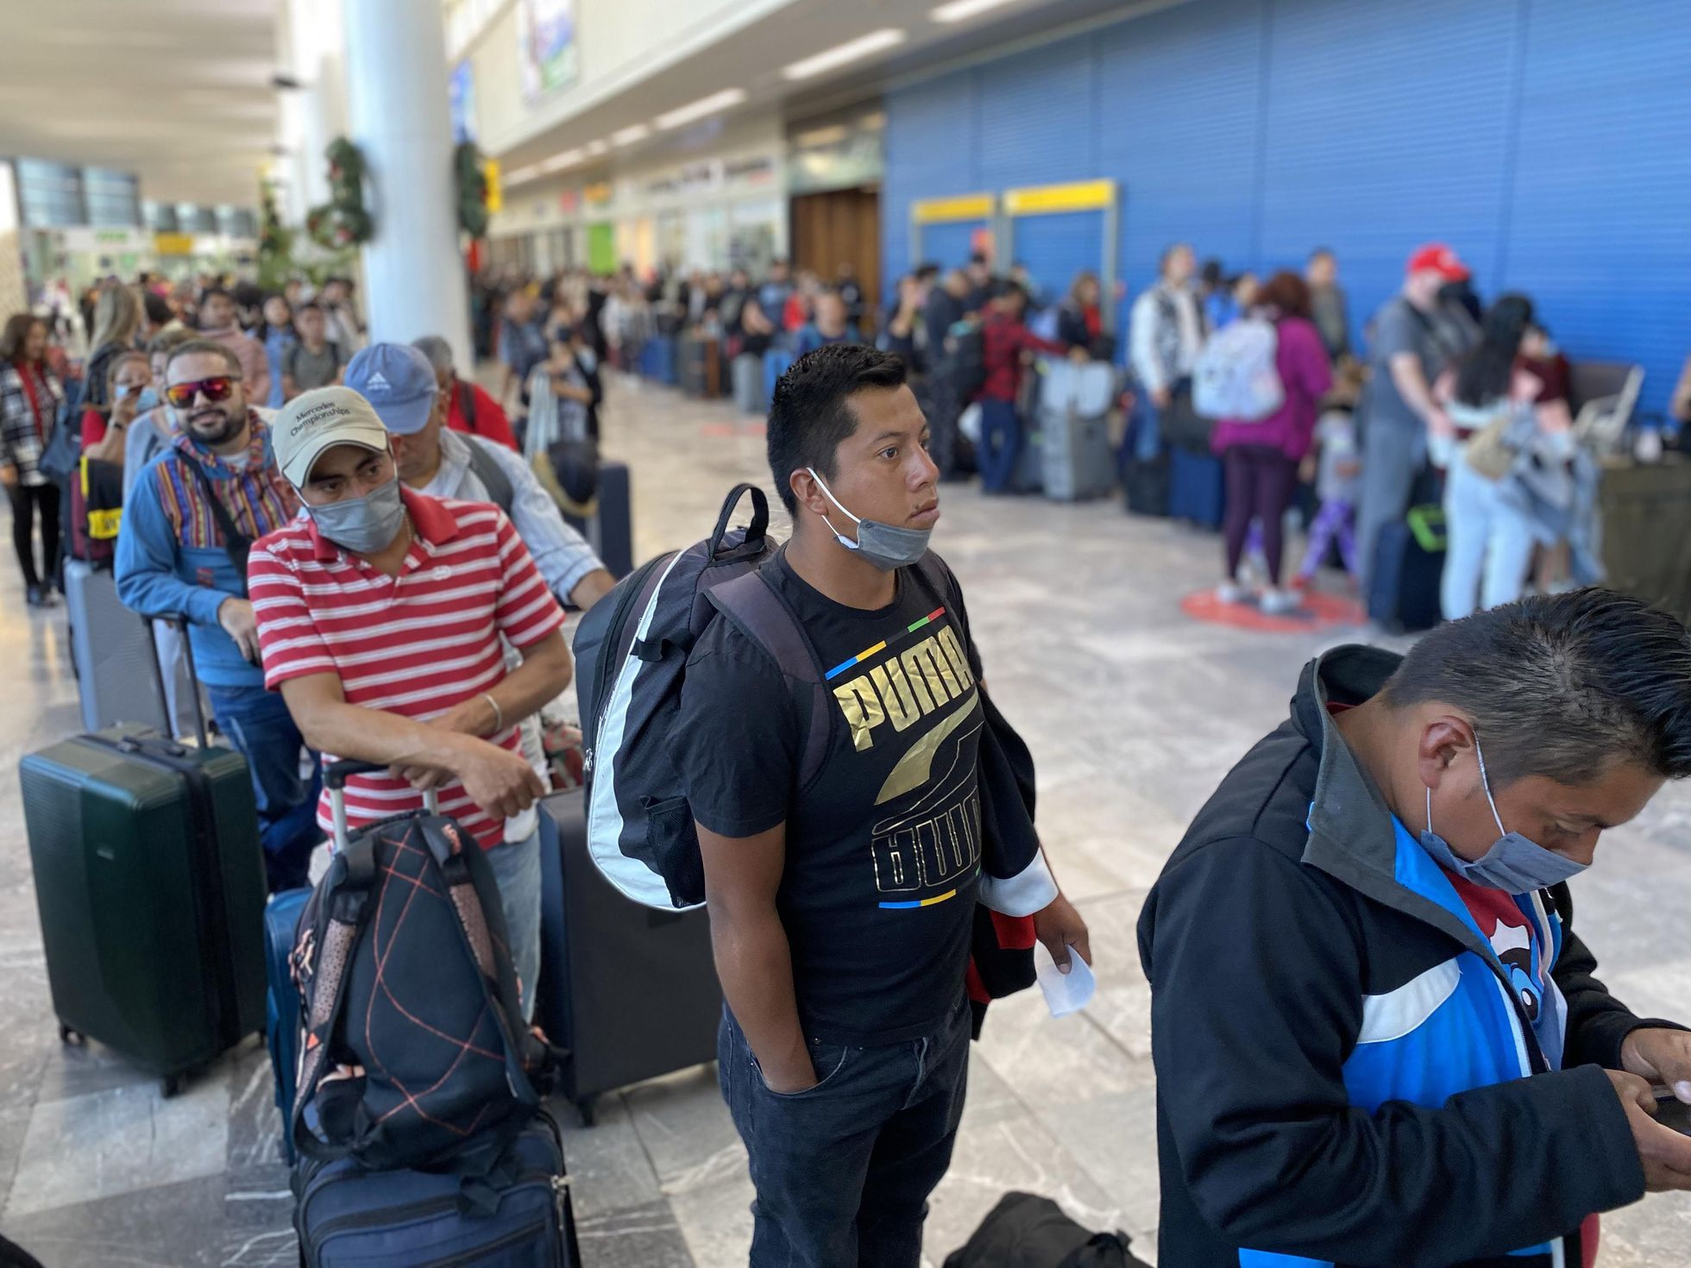
EXPENSIVE FLIGHTS
$2,672 for 2 Plane Tickets
Notes:
ALEX

Slide 12
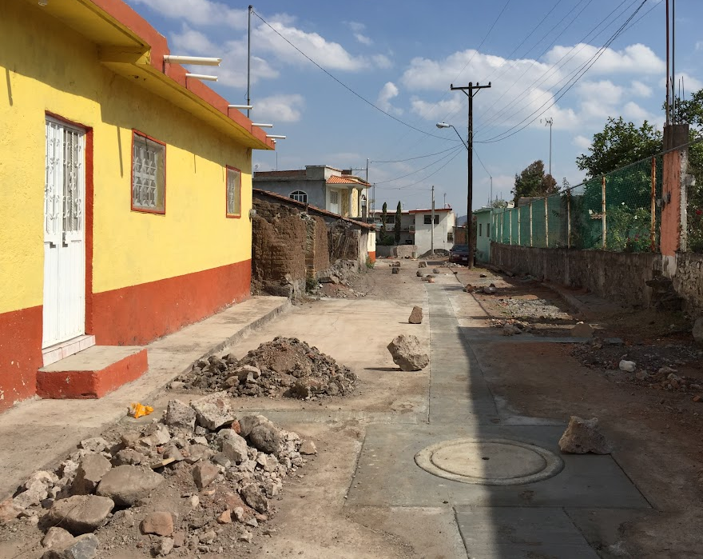
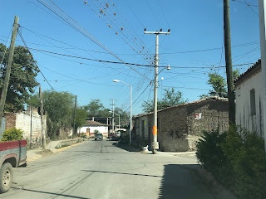
TRAVEL CONCERN
Safety
Travel Delays
Difficult Road Conditions
Cell Phones
GPS
Group Travel
Notes:
DEE
Cartel–100-1000
Quota
Police
Cross the border
Risk of multiple stops

Slide 13
SO YOU HAVE ARRIVED IN MEXICO… NOW WHAT?
No Beach
No Parasailing
No Frozen
Beverages
No
Sun Bathing
This is not your typical trip to Mexico...
Get Ready for Las Posadas
Notes:
DEE
Add bike roadway video 3:04- Until whatever stop time
https://www.youtube.com/watch?v=e4uhy3dn3ok
No phones, no tvs, no concept of time, no smart watches,--immersed in socializing–cut off completely
Return refreshed
Story telling, bonfires, kids play

Slide 14
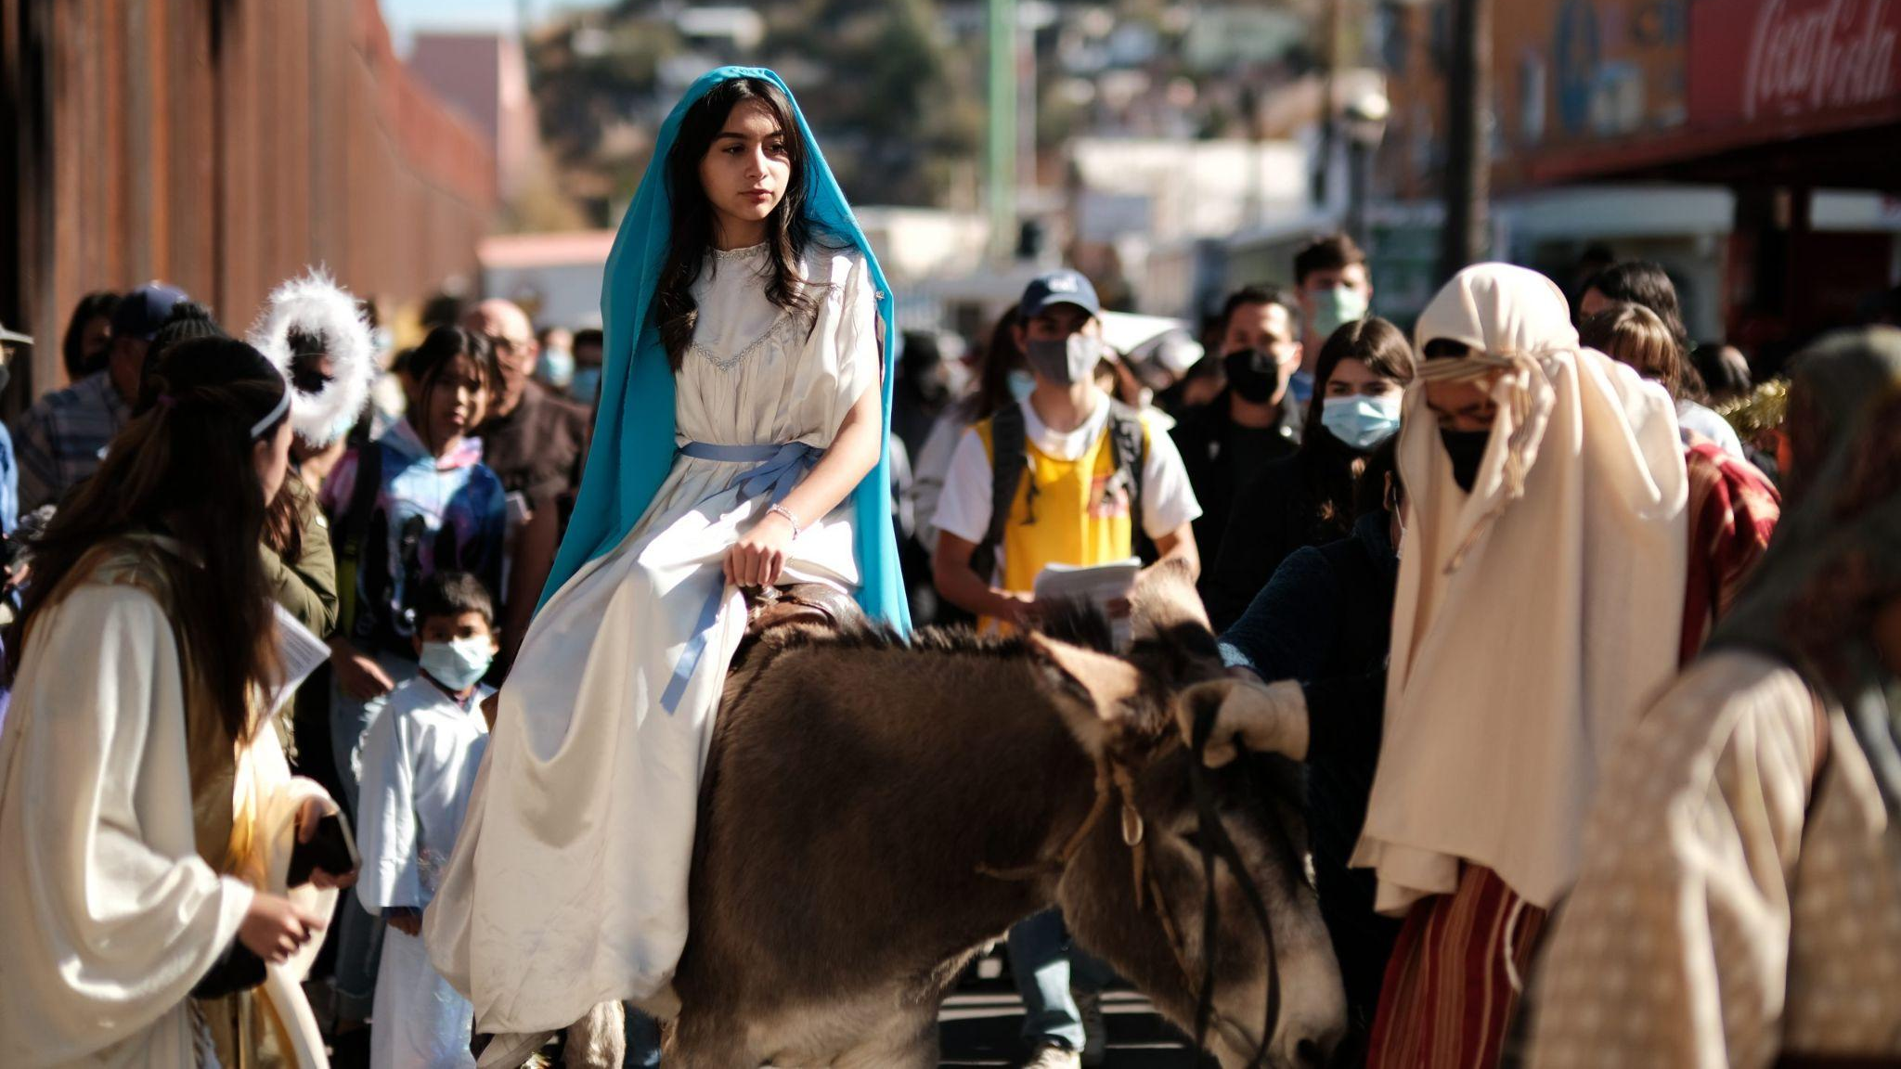
POSADAS: DECEMBER 16 - 24
Las Posadas represent the journey that Joseph and Mary made from Nazareth to Bethlehem in search of a safe shelter where Mary could give birth to the baby Jesus.
Hosted in a different house every night from Dec. 16 - 24.
Guests are invited to eat a traditional meal, pastries, beverages, music, and a piñata for the kids.
Notes:
Dee
Las Posadas represent the journey that Joseph and Mary made from Nazareth to Bethlehem in search of a safe shelter where Mary could give birth to the baby Jesus.
A posada is held in a different house every night
The guest are invited to eat a traditional meal, pastries, and beverages, enjoy music, and lastly a piñata for the kids

Slide 15
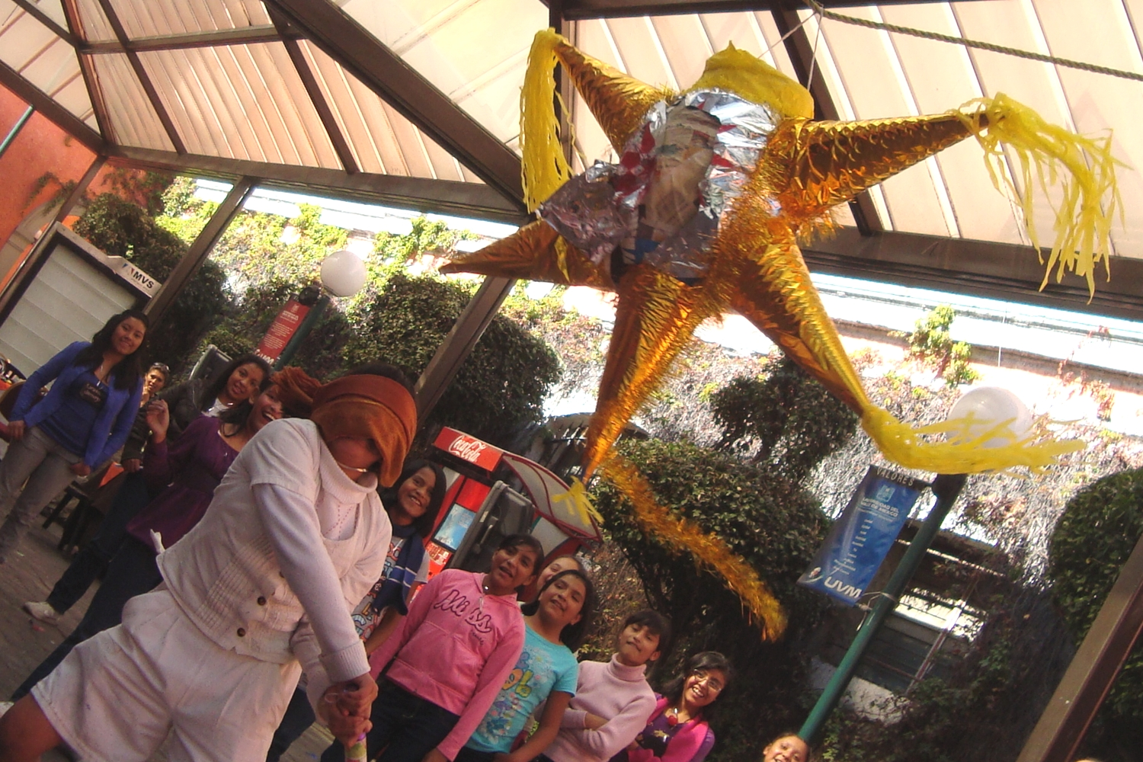
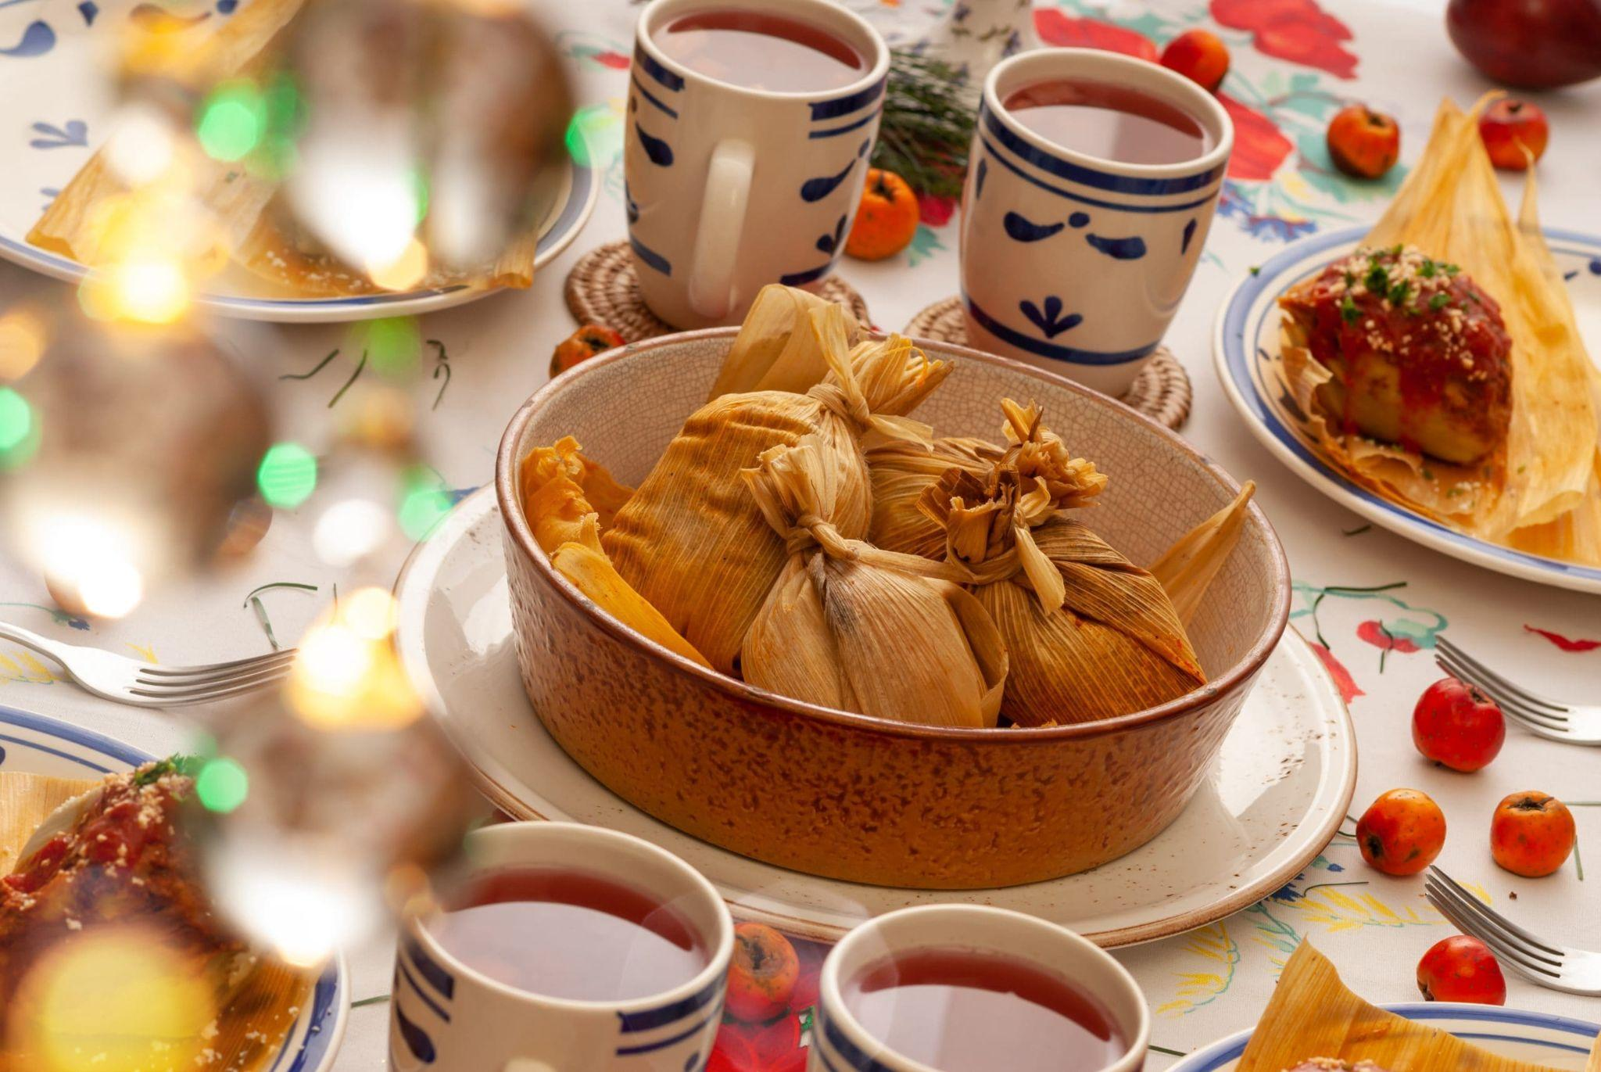
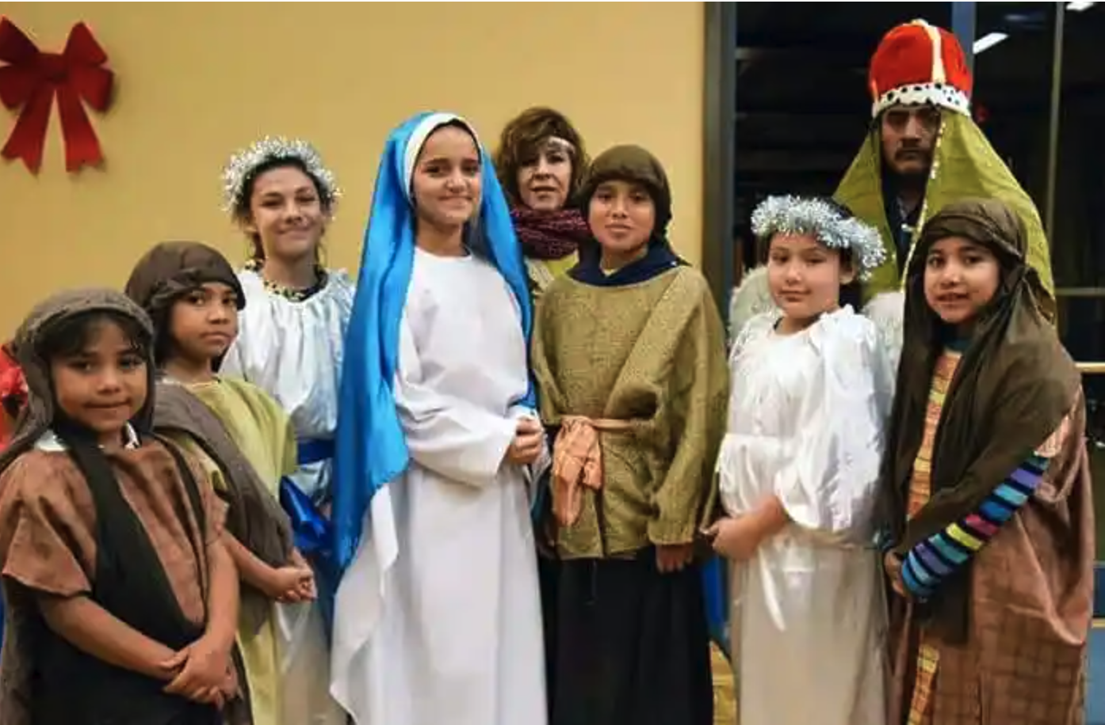
CONCURRENTLY...
As Las Posadas occur each day, other events are being held.
Notes:
Dee

Slide 16
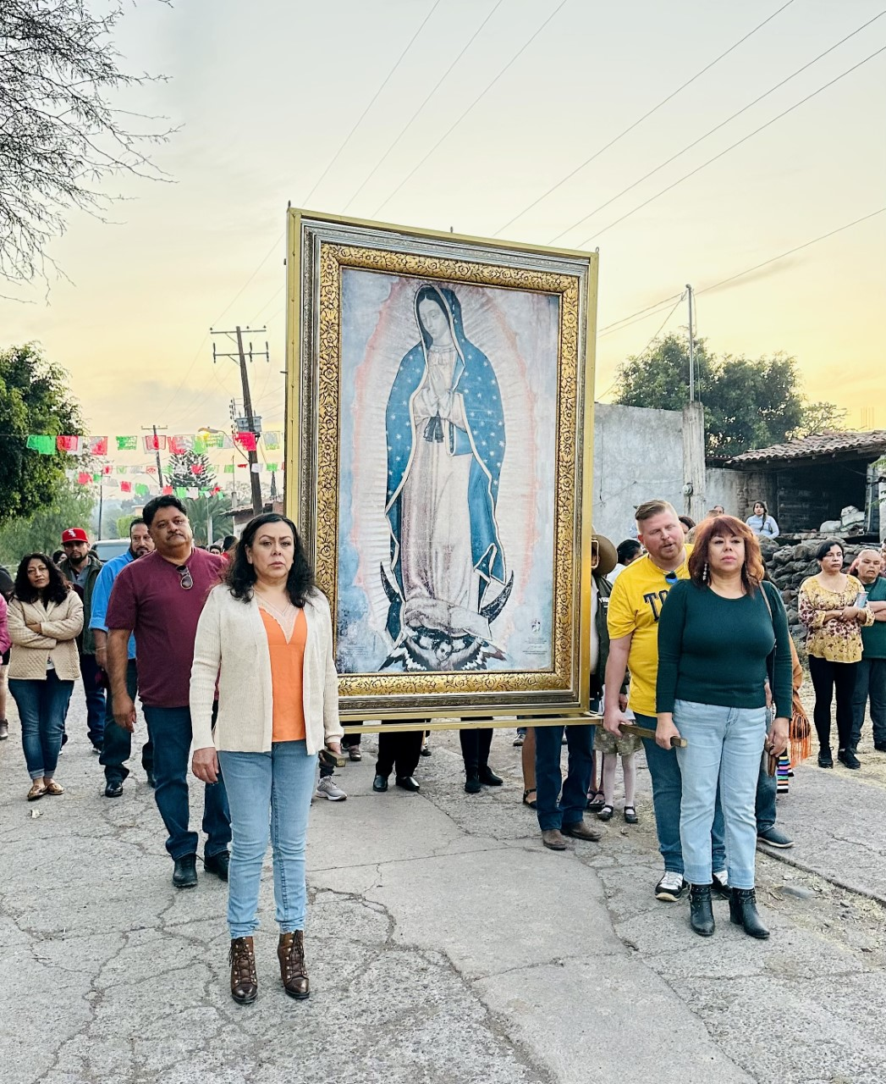
WHY DO WE CELEBRATE THE VIRGEN de GUADALUPE?
Symbol of Mexico's Catholic faith.
Represents: unconditional love and protection, miracles, healing.
Mandas (Offerings) = A good time of the year to honor Mary
(Some people crawl on their knees toward the church, into her alter, as a way of giving thanks for prayers answered).
Passing on tradition to the next generation.
Notes:
Add Bronaugh Tumulty video (VIDEO ON NEXT SLIDE)
https://www.youtube.com/watch?v=nCuPuNtcx6E&ab_channel=WGNNews

Slide 17
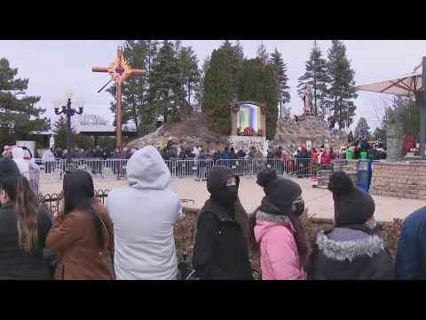
Notes:
Add Bronaugh Tumulty video
https://www.youtube.com/watch?v=nCuPuNtcx6E&ab_channel=WGNNews

Slide 18
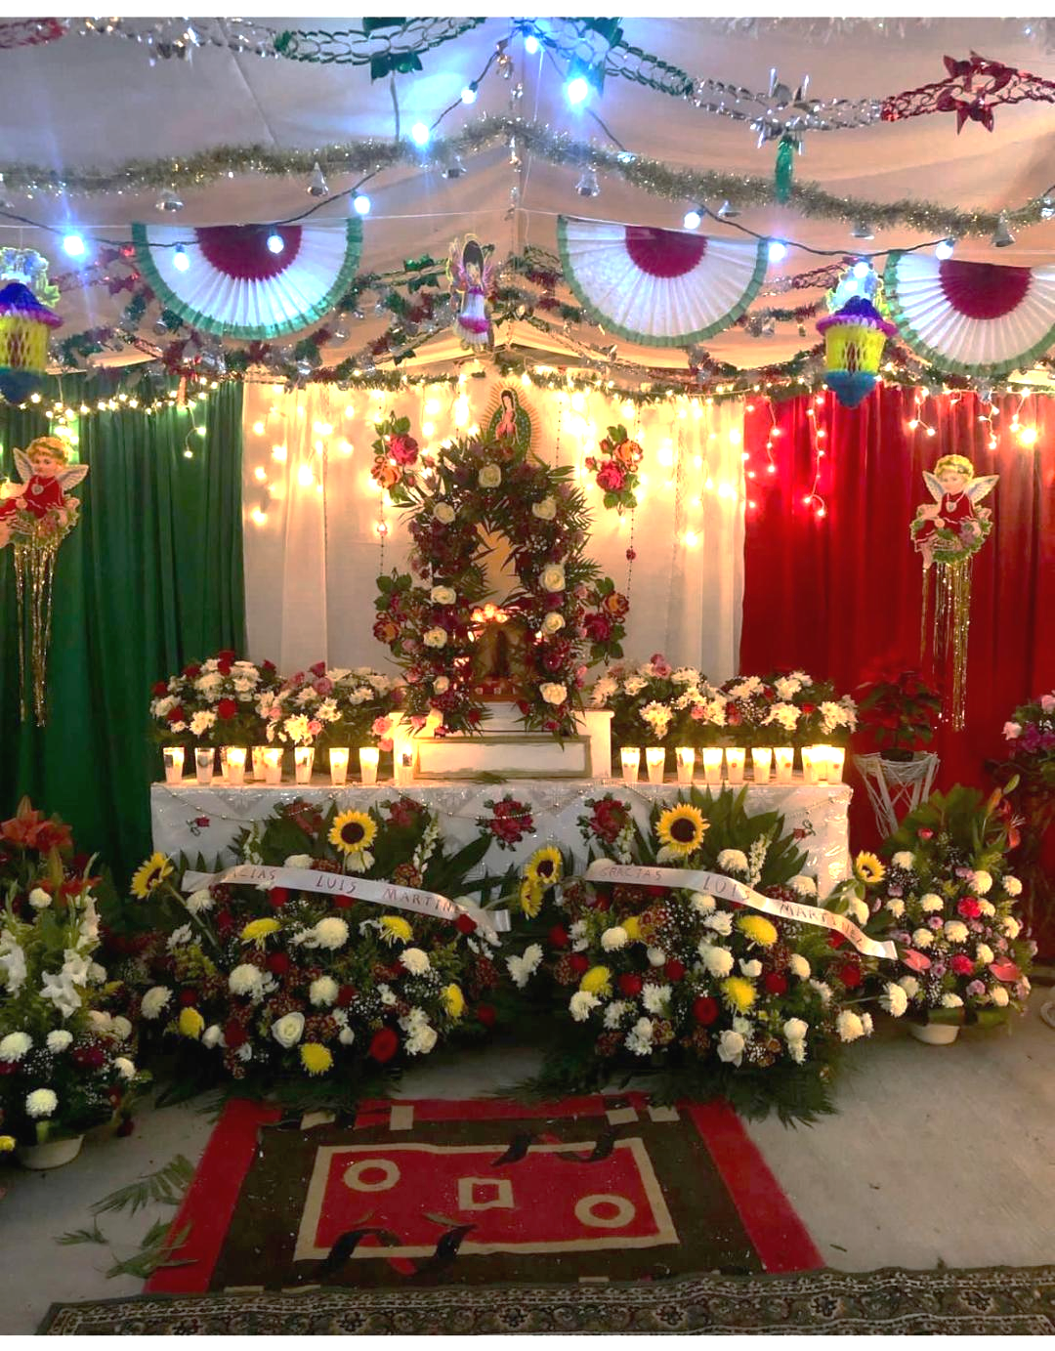
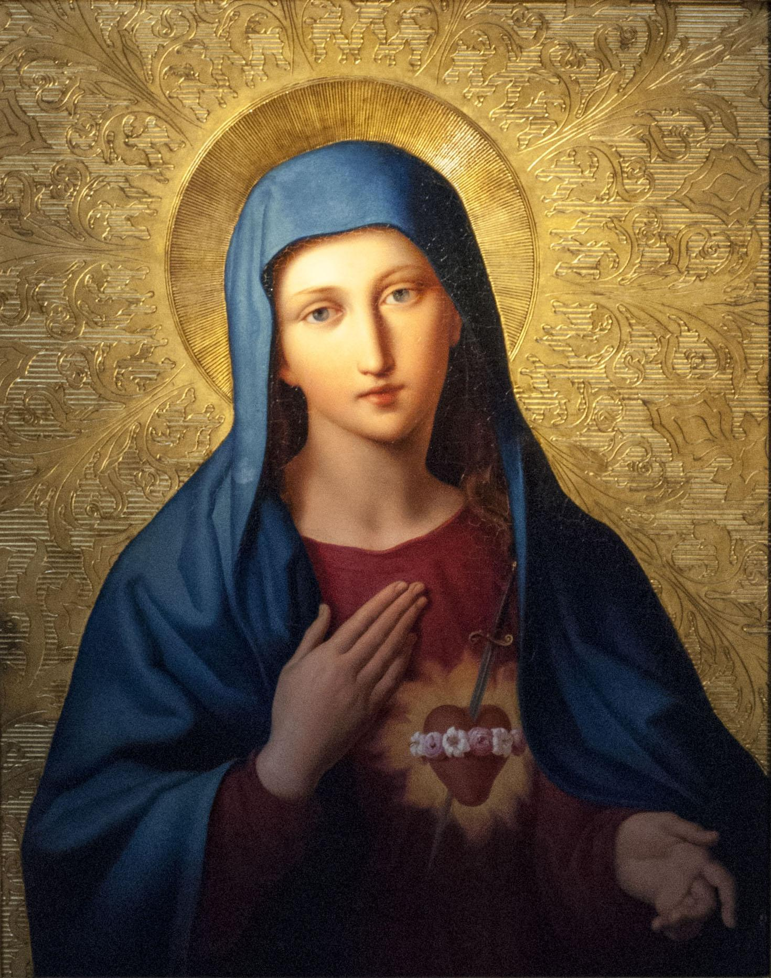
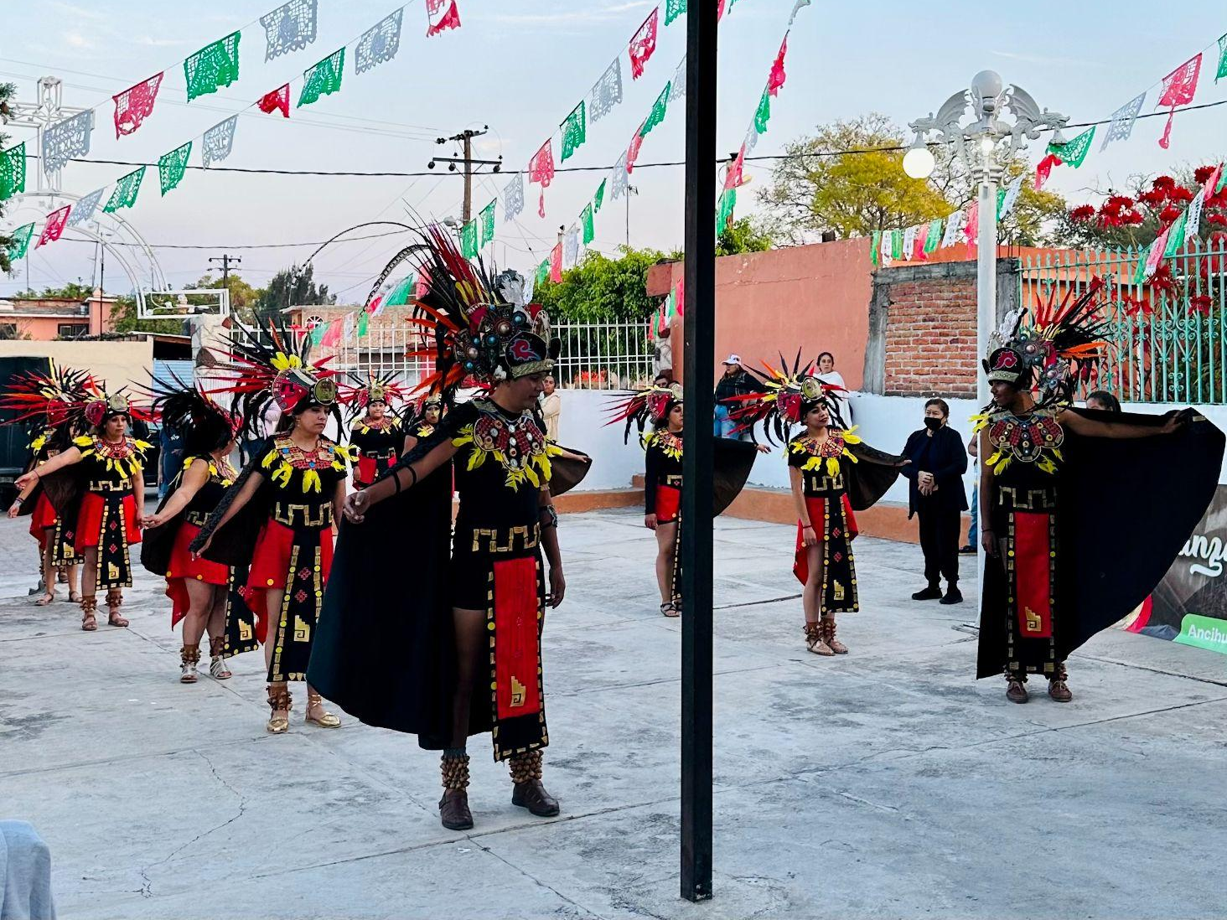
NOVENA/NOVENARIO:
DECEMBER 20 - 28
DAY 1 - December 20
4:30 PM Mass
After Mass, community members walk with the Virgin of Guadalupe to the designated family’s house where the novena will be held for the following 9 days.
Offerings, such as Candles and Flowers are accepted
Next 8 Days
At 5:30 PM, everyone in the village is welcome to come and prays the Rosary.
After the Rosary, the family hosting the novena will provide pastries and beverages for every person who attends.
Entertainment is optional (Baile Folklorico, Danza, Music, Mariachi)
Notes:
00:10-0:49
video on next page
https://youtu.be/HlwN-TSCiPI

Slide 19
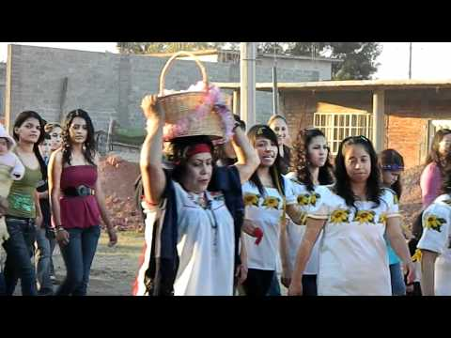
Notes:
https://youtu.be/HlwN-TSCiPI

Slide 20
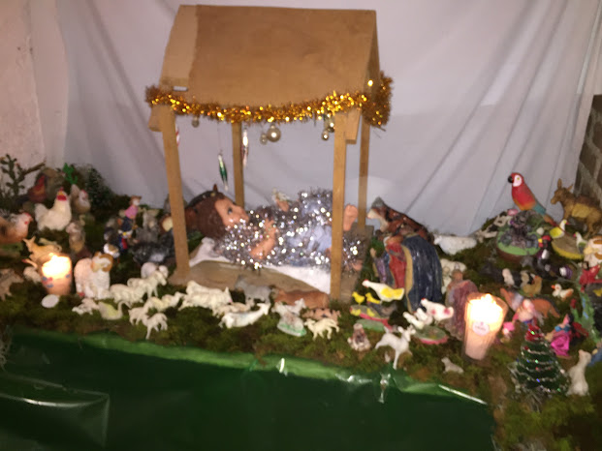
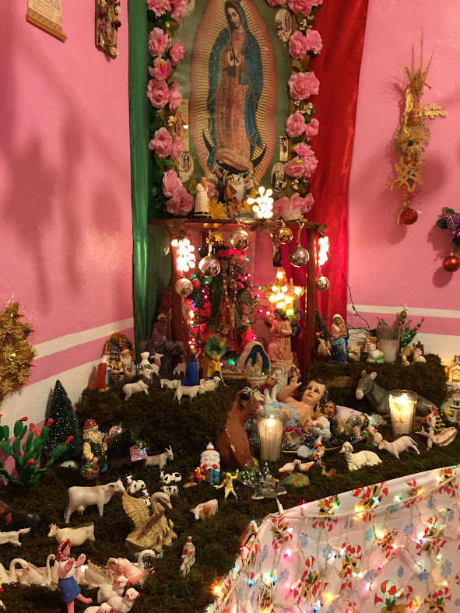
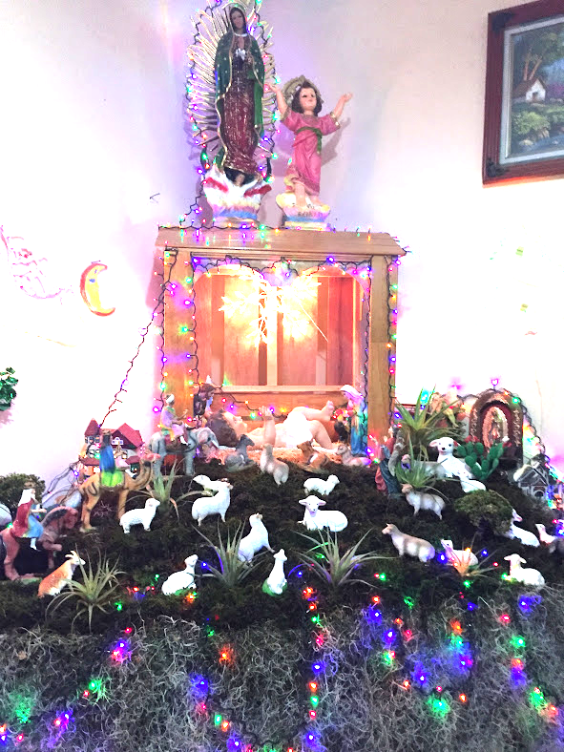
CHRISTMAS EVE - DECEMBER 24
The last posada is held in the village church.
At Midnight, visit and kiss Baby Jesus at each house that has a nativity scene display.
Receive an Aginaldo (Goody bags, grateful to the community, modest treat, equivalent gift for kids, that the Kings brought for baby Jesus upon his birth).
Notes:
PASS OUT GOODIE BAGS–KANE ROE HELP
Door to Door like Halloween

Slide 21
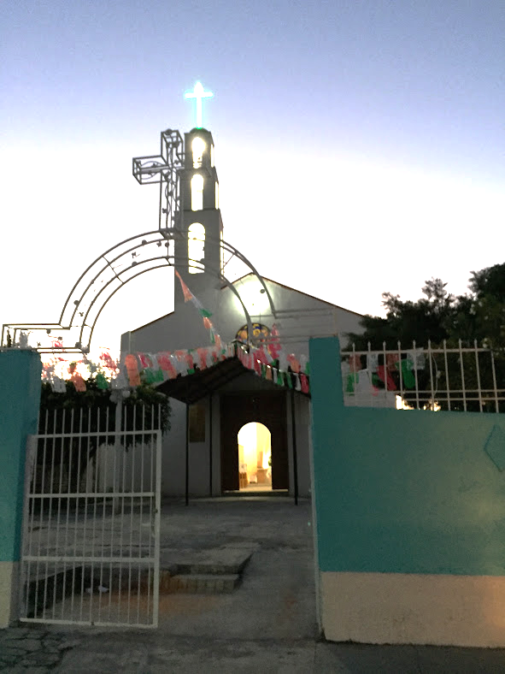
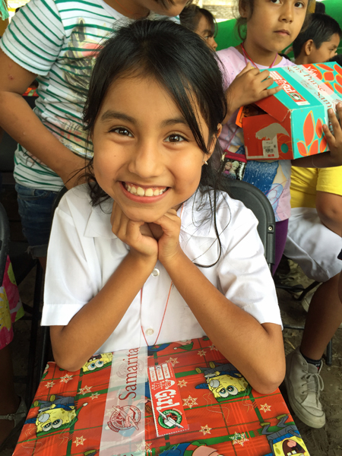
CHRISTMAS DAY: DECEMBER 25
The godparents gather at the church to give all children in the village a gift.
Notes:
ALEX
Newer Tradition–brought from the US

Slide 22
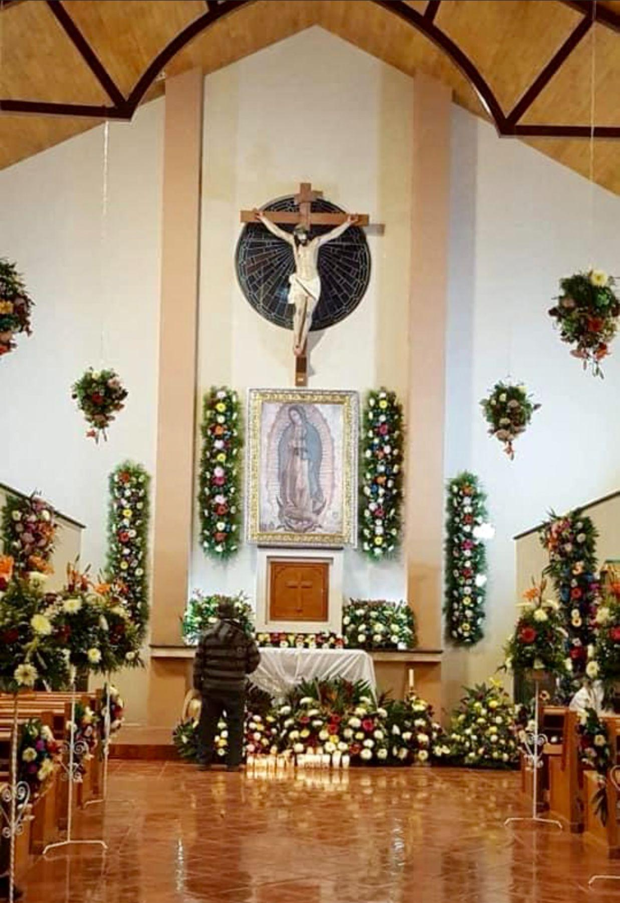
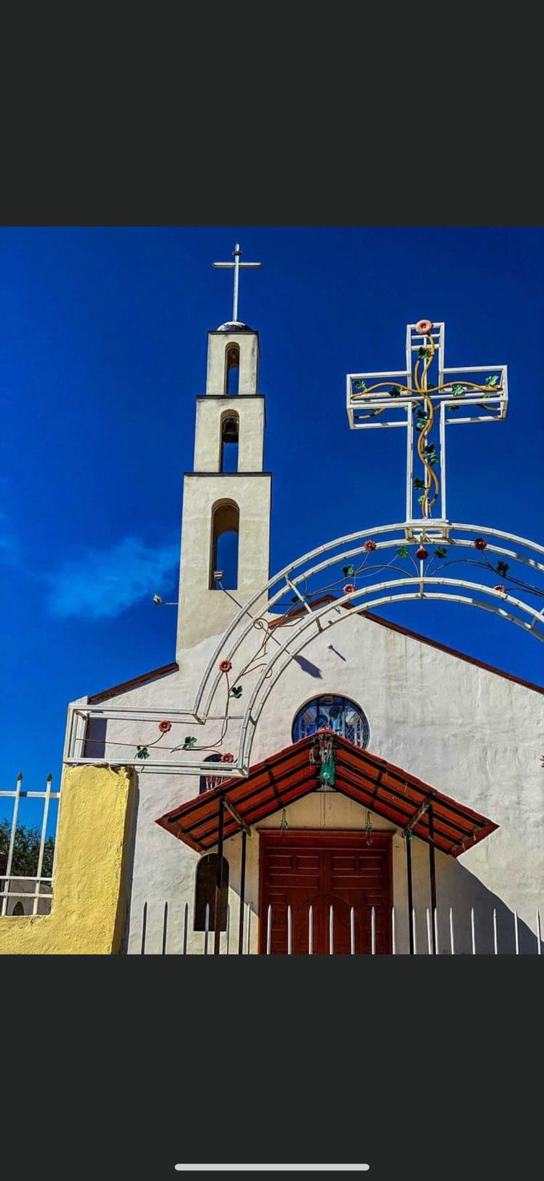
FIESTA PATRONAL
Mexican tradition - honor their patron saint.
Both a traditional religious activity and a lively secular celebration centered around the village church and plaza.
Give thanks to the Virgin of Guadalupe for the blessings given upon the people and the village.

Slide 23
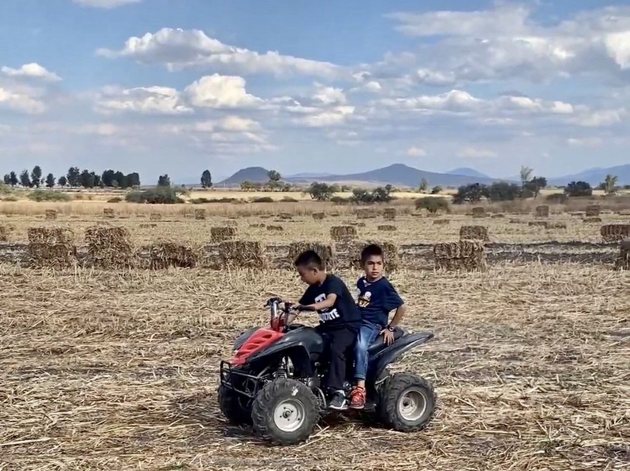
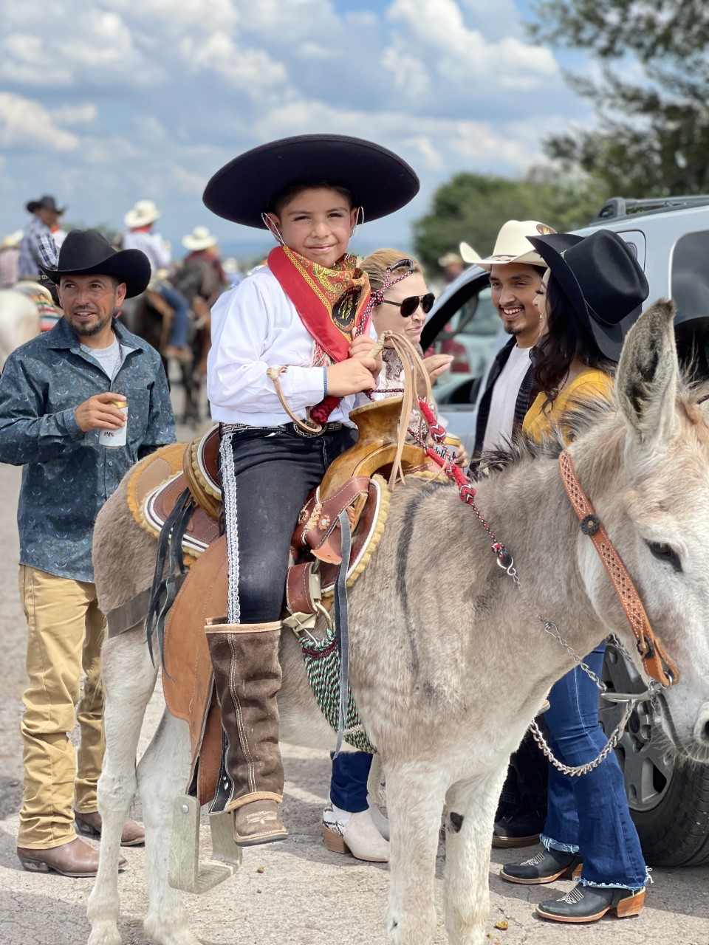
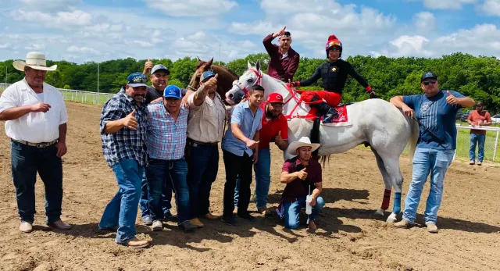
ENTERTAINMENT RACES: DECEMBER 26
Family friendly event.
Horses, ATV’s, Adults, and Children.

Slide 24
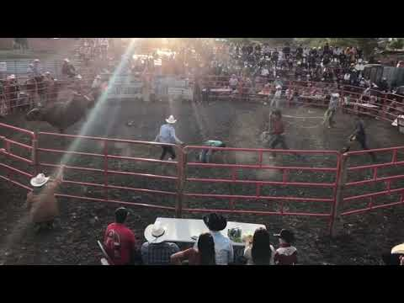
ENTERTAINMENT JARIPEO (RODEO/ BULL RIDING)
DECEMBER 27
A full day event of bull riding and family friendly entertainment
Merchants set up to sell food, games, goods
Notes:
Jaripeo Youtube 3:35-3:55—- Can we Delete this video, and use this shorter version from gopro please https://gopro.com/v/LvGXrp2zylXXo

Slide 25
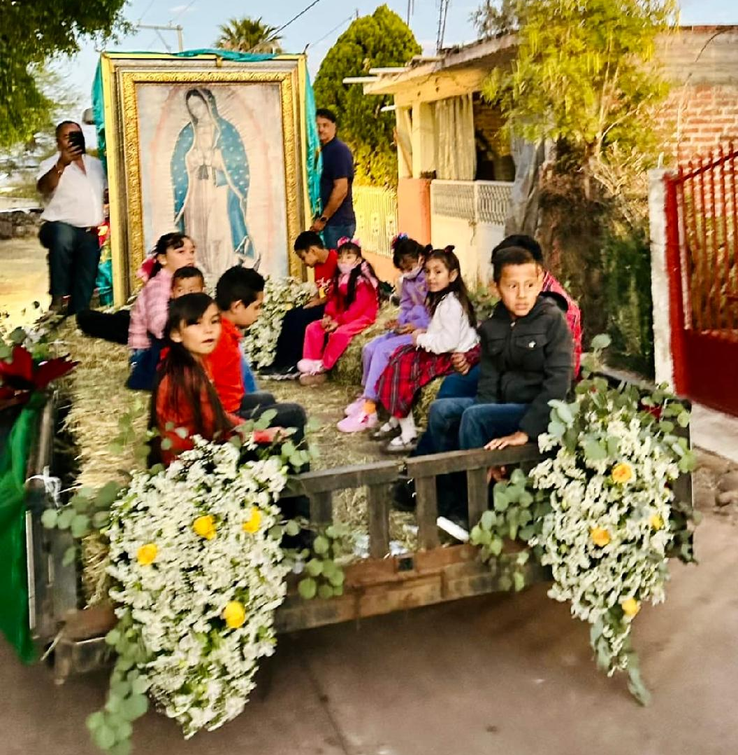
FIESTA PATRONAL - DAY 1: DECEMBER 28
5:30 PM last rosary at the hostess house
The community members gather to parade the Virgin of Guadalupe through the entire village, with the last destination being the church.
7:00 PM Mass
9:00 PM Dance
Notes:
Entire Video.
Video on next page: https://youtu.be/XMkChCP0AVc

Slide 26
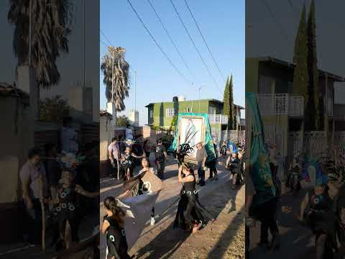

Slide 27
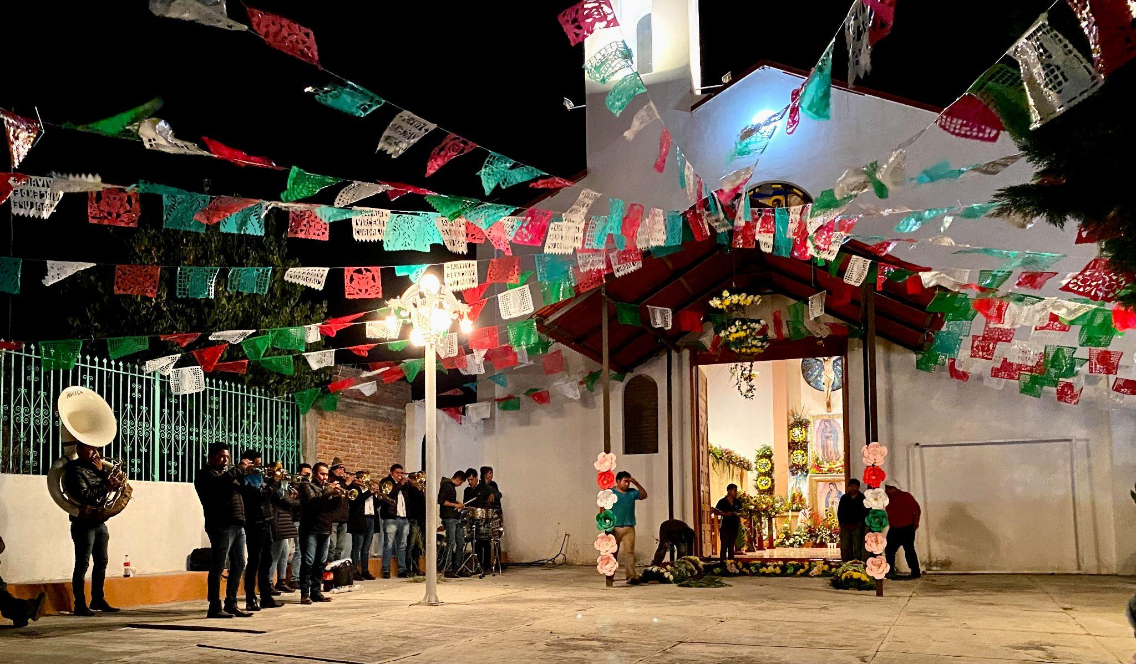
FIESTA PATRONAL - DAY 2: DECEMBER 29
7:00 AM The community members gather at the church, community members will walk through the entire village with a band, firework are set off
Some people will set up a hot beverage station outside of their house. The band will stop at each house with a station and play music.
The band will circle toward the church (They will likely play for the duration of 12 hours)
2:00 PM Mass
7:30 PM Traditional Dance Performance
9:00 PM “Castillo”
A firework tower display is set off
9:00 PM Dance Starts
Notes:
video on next page

Slide 28
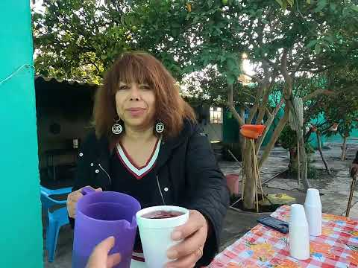

Slide 29
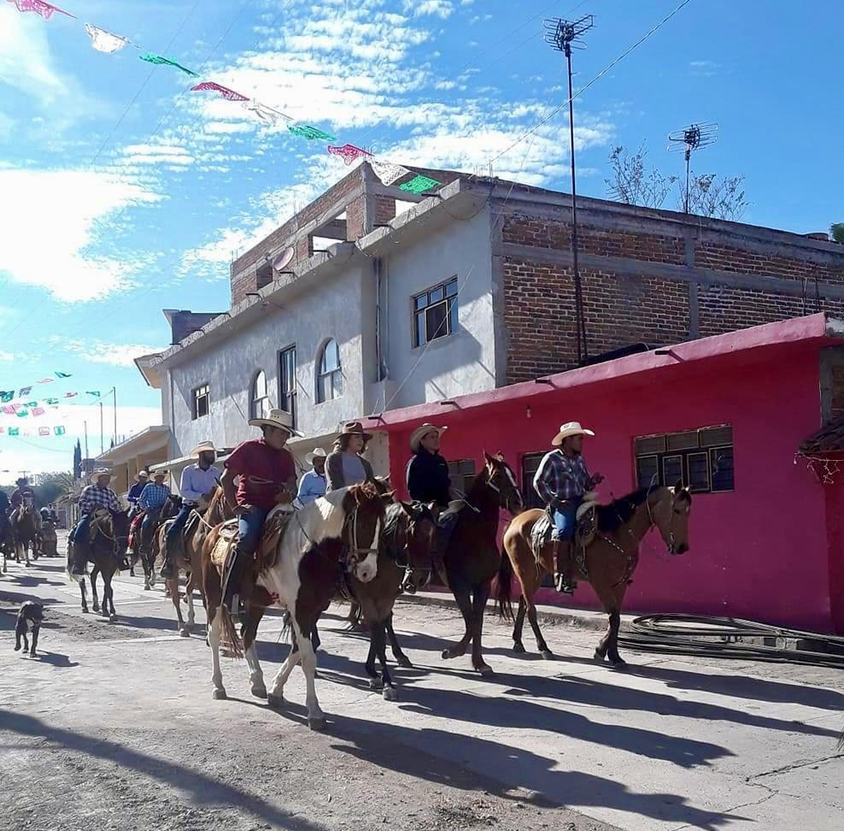
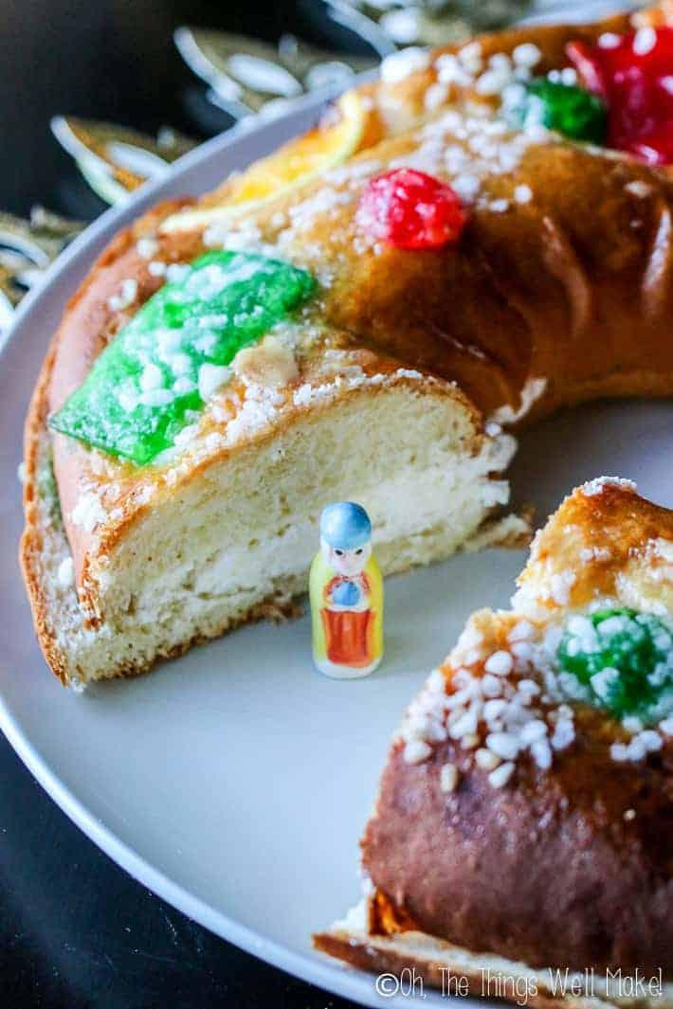
“DIA DE LOS REYES MAGOS” THE THREE WISE MEN
JANUARY 6
Children place their shoe outside of the door and receive gifts from the Three Wise Men
A Calvagata de Los Reyes Magos is arranged to symbolize the arrival of the kings.
(Men ride their horses and parade through the streets of the village.)
Celebrate with “Rosca de Reyes” /Kings Cake
Attend church
Levantamiento del Niño Dios/ Waking Baby Jesus Dressing him up.
Notes:
Alex

Slide 30
GETTING READY TO SAY GOODBYE
TO FAMILY AND FRIENDS...
Prior to returning to the states, community members will sign up for a raffle. The raffle is to determine who will sponsor religious events for the following year–
The main prize being the Virgin of Guadalupe at their house
Church decorations, Castillo, Band for the Virgin of Guadalupe, Dance Performance, etc.
All of this, to demonstrate gratitude to the Virgin of Guadalupe.
Let the planning for next year begin!
Notes:
Dee

Slide 31
So….What do we do with this information?
Share Perspective w Others
Adult decisions not the children
Tradition rooted in Religion & Mexican culture.
Punish the Students-Does this work?
Embrace & Adapt–digging in heels -make the best of it
Not about excused or unexcused absences–this is about the opportunity to learn
Attendance Policy Equity
Are children treated equally-parental requests for time out of school including Disney, regularly missing for non-sponsored school activities such as hockey, gymnastics, etc.
Notes:
Dee

Slide 32
Tips for Successful Learning
Open lines of communication with Parents-avoid judgment
Schools needs to be prepared to have students absent-look at overall student population
Understand the limitations of access to Internet, Phone, Etc…
Discuss options for children to present their experiences at school
Offer special assignments related to trip
Manage student’s other attendance related issues that need to be addressed outside of this one time a year issue
Notes:
Dee

Slide 33
SUGGESTIONS FOR FAMILIES/STUDENTS
Avoid other absenteeism throughout the school year
Communicate in advance with teachers/school about trip
Discuss challenges of completing standard homework assignments and consider options for sharing their experience
Incorporate discussions of school content areas into the planning and participation of the trip to Mexico
Make up required assignments in a timely manner
Double check supplies before leaving (notebook, highlighter etc.)
Journal the experiences (paper/pencil)
Research the destination
Independent reading book for the trip
Find ways to have children calculate mileage, budget, other expenses

Slide 34
WHY SCHOOL ACCEPTANCE
MATTERS?
FOOD FOR THOUGHT
Do the school staff provide a feeling of belonging–sense of acceptance, respect, inclusion & support in a learning environment by embracing the culture of the students served?
Do you perceive that family trips help children to feel connected through a shared experience, exploration, patience, creativity, tolerance, and new learning.
How is diversity universally accepted or ignored in the classroom?
Notes:
Dee

Slide 35
ADIÓS
Q & A
Contact Information:
Dr. Deanna Oliver- doliver@kaneroe.org
Ms. Alex Moreno- amoreno@kaneroe.org
Photo Credit: Google & Alex Moreno

Slide 36
Sources:
https://www.colorincolorado.org/article/culturally-responsive-instruction-holiday-and-religious-celebrations
https://www.travelandleisure.com/trip-ideas/family-vacations/why-i-take-my-kids-out-of-school-to-travel
https://soeonline.american.edu/blog/benefits-of-inclusion-and-diversity-in-the-classroom/
https://www.education.vic.gov.au/Documents/parents/going-to-school/Missing%20school%20for%20cultural%20reasons.pdf
https://www.edweek.org/leadership/opinion-kids-who-take-vacations-in-the-middle-of-the-school-year/2015/01
https://ced.ncsu.edu/news/2021/10/21/why-is-it-important-for-students-to-feel-a-sense-of-belonging-at-school-students-choose-to-be-in-environments-that-make-them-feel-a-sense-of-fit-says-associate-professor-deleon-gra/
https://www.scholastic.com/parents/family-life/parent-child/missing-school-family-vacation.html

